Slide 1
UNIVERSTY OF BUEA FACULTY OF ENGINEERING AND TECHNOLOGY DEPARTMENT OF COMPUTER ENGINEERING CEF 250: COMPUTER ARCHITECTURE
THE ANALYSIS, DESIGN AND IMPLEMENTATION OF
A 16 – BITS MICROCOMPUTER
Presented by
NOUPOUWO DONGMO STEPHANE MERCI: FE21A283
POKAM NGOUFFO TANEKOU: FE21A299
DJEUTIO QUOIMON ANDERSON ROY: FE21A169
TIANI PEKINS EBIKA: FE21A325
AKENGNI KEANLI EMMANUEL: FE21A132
JERRY AYUKNKEM EBAI: FE21A370
FOLAMO BENOIT: FE21A188
DEGAULLE NJUKANG NKENGAFAC: FE21A353
SUPERVISED BY:
Dr. NKEMENI VALERY
Presented on:
Sunday, June 5 2022

Slide 2
PROJECT :THE ANALYSIS, DESIGN AND IMPLEMENTATION OF A 16-BIT MICROCOMPUTER
The 16-Bit Microcomputer is a device which is aimed at performing several tasks such as: arithmetic, logical operations and much more
It is divided into two main parts :
The Central Processing Unit(CPU) Regiters
The Control Logic unit

Slide 3
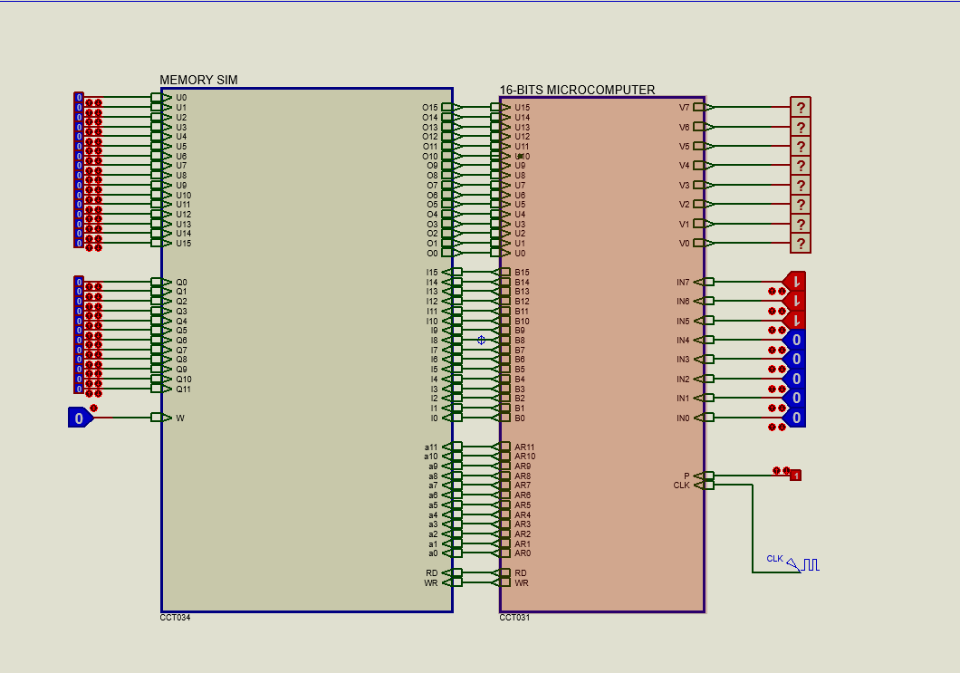
Here is a 16-bit Microcomputer designed to perform
Arithmetic operations
Logical operations
Data storage

Slide 4
The basic computer has three instruction code formats. Each format has 16 bits. The operation code (opcode) part of the instruction contains three bits and the meaning of the remaining 13 bits depends on the operation code encountered. The code formats are:
Memory – Reference instruction : Here the left most bit represents the addressing mode which can either be direct (0) or indirect(1) and the 12 through 14 bit represents the opcode and the remaining 0 through 11 bit represents an address
Register – Reference instruction : Here the 15 bit is 0 and the opcode is 111 the remaining bits specify the operation to be executed on the Accumulator
Input / Output – Reference instruction: Similar opcode as that of the register - reference, its 15 bit is 1 and the remaining bits specify the type of input / output operation performed

Slide 5
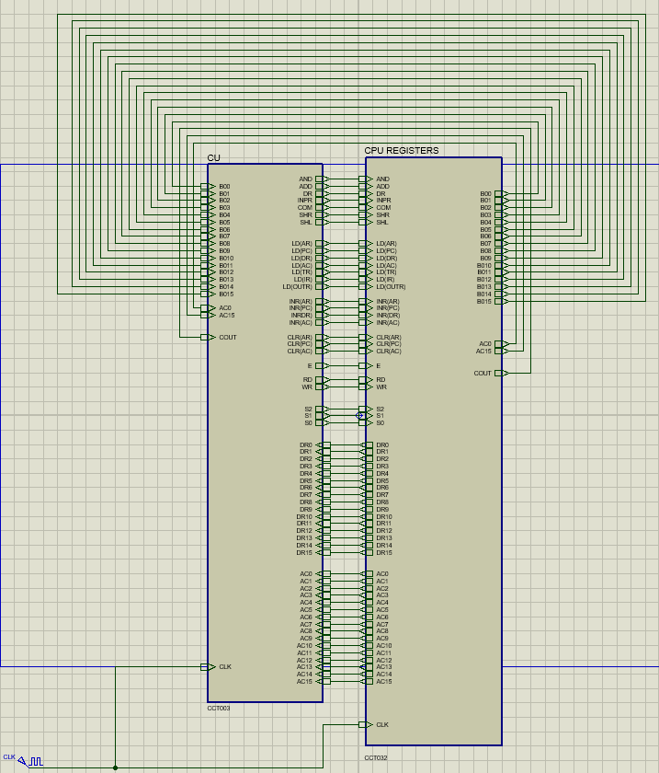
Here is the picture that shows the CPU Registers and Control unit are interconnected

Slide 6
Here is the picture that shows how the Microcomputer is divided into two main parts
When the when the user enters the inputs, they enter the CPU Registers and Control Unit
The output of both circuits are being sent to the output register

Slide 7
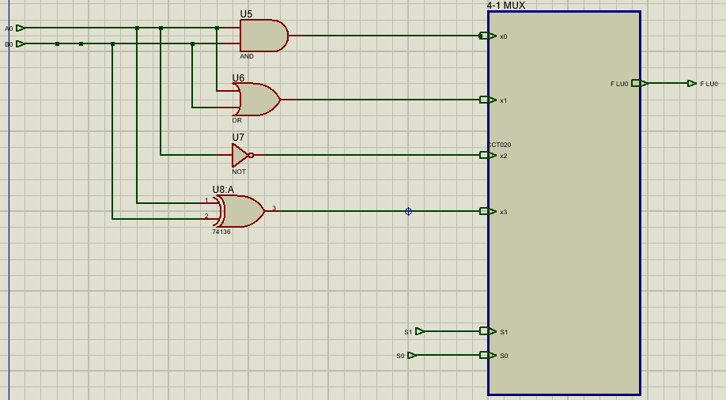
Now this is the Control unit which decides which operation should be performed on the input values

Slide 8
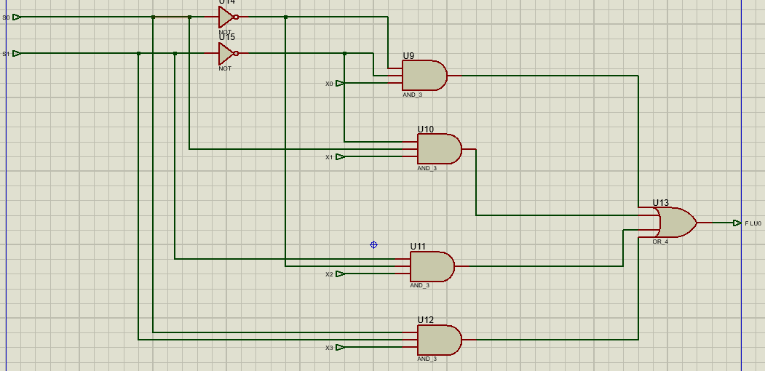

Slide 9
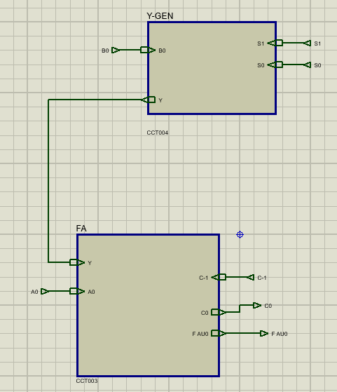
Here is a picture of the logic unit which consists of a y-gen, and a full adder and a c-gen
The y-gen is aimed at changing the value of ‘B’ with repect to the operation we want to do
The c-gen is to generate the initial carry in with respect to s0 and s1
And the full adder is to add the values of ‘A’, ‘B’ and the carry

Slide 10
In the arithmetic unit , operations are made with respect to the following equations ;F=A+B+Cin
For Addition
F=A+B+0
For Subtraction
F=A+B+1
For Inrement
F=A+0+1
For Decrement
F=A+1+0
We can see that the values of ‘B’ and ‘Cin’ are changing for each operation hence the use of the y-gen and c-gen

Slide 11
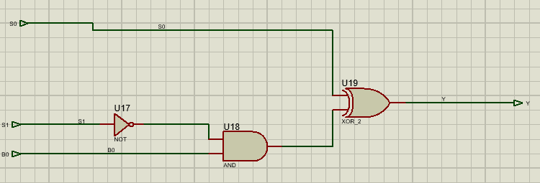
For the y-gen
S1 | S0 | B | Y
0 | 0 | 0 | 0
0 | 0 | 1 | 1
0 | 1 | 0 | 1
0 | 1 | 1 | 0
1 | 0 | 0 | 0
1 | 0 | 1 | 0
1 | 1 | 0 | 1
1 | 1 | 1 | 1
S1S0B | 0 | 1
00 |  | 1
01 | 1
10 | 1 | 1
11
Y=S0 xor (S1B)

Slide 12
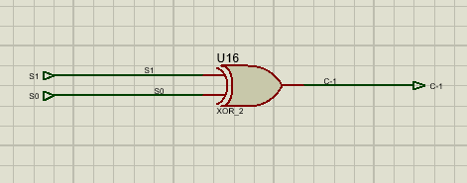
For c-gen
S1 | S0 | Cin
0 | 0 | 0
0 | 1 | 1
1 | 0 | 1
1 | 1 | 0

Slide 13
After generating ‘Cin’ and ‘Y’ , they both enter into the full adder which adds ‘A’,’Y’, and ‘Cin’ and produces ‘Cout’ and ‘F AU’ as outputs
input |  |  | Output
A | B | Cin | Cout | F AU
0 | 0 | 0 | 0 | 0
0 | 0 | 1 | 0 | 1
0 | 1 | 0 | 0 | 1
0 | 1 | 1 | 1 | 0
1 | 0 | 0 | 0 | 1
1 | 0 | 1 | 1 | 0
1 | 1 | 0 | 1 | 0
1 | 1 | 1 | 1 | 1
ABCin | 00 | 01 | 11 | 10
0 |  |  | 1
1 |  | 1 | 1 | 1
Cout= Cin(A+B)+AB
ABCin | 00 | 01 | 11 | 10
0 |  | 1 |  | 1
1 | 1 |  | 1
F AU= Cin xor A xor B

Slide 14
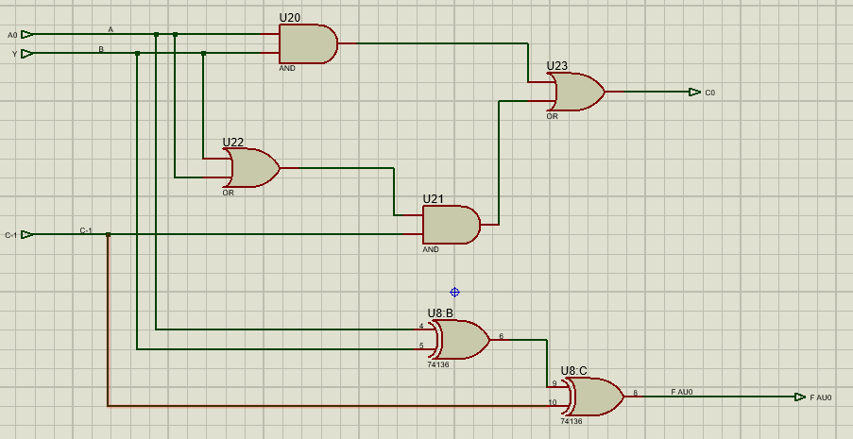
Now here is the combined circuit that takes input ‘A’ ,’Y’, and ‘Cin’ to produce Cout and F AU
The carry out passes through an AND gate with S2 to produce a carry when the operation is arithmetic and the carry is taken to the next ALU where it acts as the carry in for that ALU hence only the first ALU has a c-gen

Slide 15
Now after the arithmetic unit has produce output ‘F AU’ and the logic unit produce its own ‘F LU’ , both of the output enter in the 2-1 multiplexer whose aim is to choose which of the two output is to be the result
If S2=0 the output will be ‘F AU’ and
If S2=1 the output will be ‘F LU’ .

Slide 16
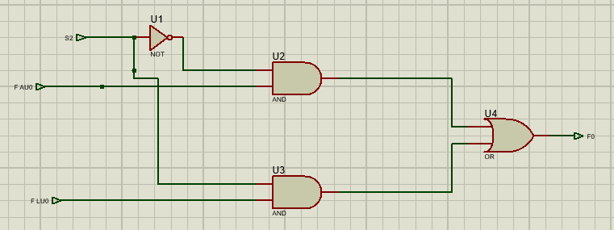
Here is the circuit diagram that shows how the 2-1 multiplexer functions
S2 | F
0 | F AU
1 | F LU
F=S2(FAU)+S2(FLU)

Slide 17
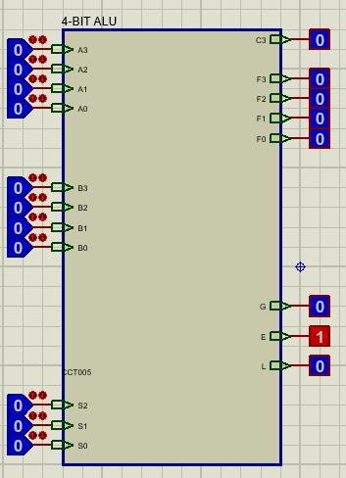
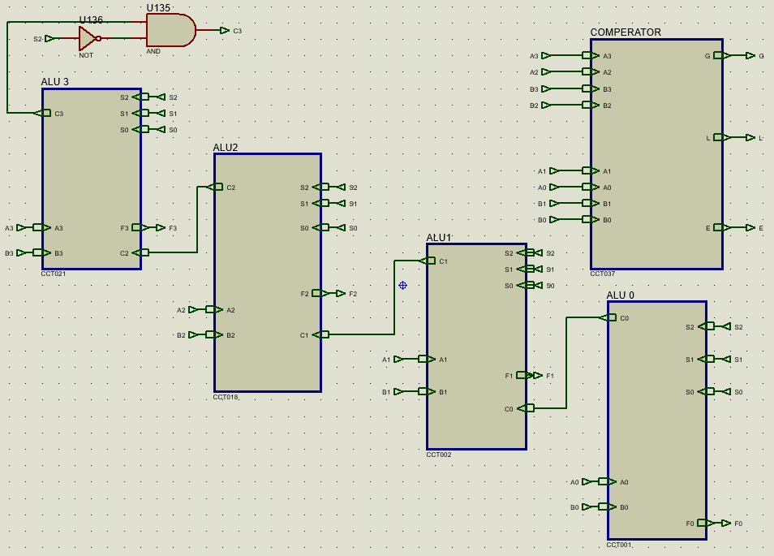

Slide 18
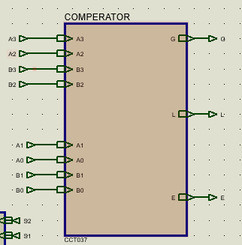
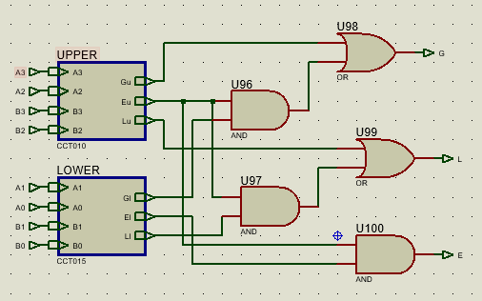
COMPERATOR
The comperator is the device used in comparing ‘A’ and ‘B’
Here, the two most significant bits are compared and the two least significant bits are also compared. With respect to some conditions that will be stated , the output is given
G | A>B
E | A=B
L | A<B
Gu | A3A2>B3B2
Eu | A3A2=B3B2
Lu | A3A2<B3B3
Gl | A1A0>B1B0
El | A1A0=B1B0
Ll | A1A0<B1B0

Slide 19
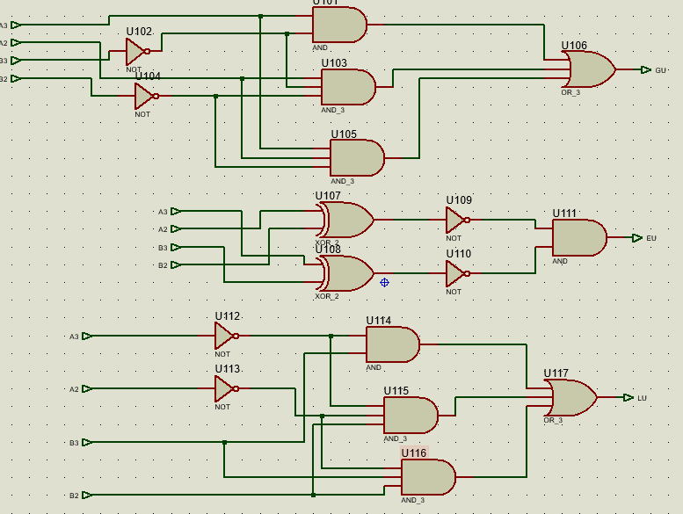
inputs |  |  |  | Outputs
A3 | A2 | B3 | B2 | Gu | Eu | Lu
0 | 0 | 0 | 0 | 0 | 1 | 0
0 | 0 | 0 | 1 | 0 | 0 | 1
0 | 0 | 1 | 0 | 0 | 0 | 1
0 | 0 | 1 | 1 | 0 | 0 | 1
0 | 1 | 0 | 0 | 1 | 0 | 0
0 | 1 | 0 | 1 | 0 | 1 | 0
0 | 1 | 1 | 0 | 0 | 0 | 1
0 | 1 | 1 | 1 | 0 | 0 | 1
1 | 0 | 0 | 0 | 1 | 0 | 0
1 | 0 | 0 | 1 | 1 | 0 | 0
1 | 0 | 1 | 0 | 0 | 1 | 0
1 | 0 | 1 | 1 | 0 | 0 | 1
1 | 1 | 0 | 0 | 1 | 0 | 0
1 | 1 | 0 | 1 | 1 | 0 | 0
1 | 1 | 1 | 0 | 1 | 0 | 0
1 | 1 | 1 | 1 | 0 | 1 | 0

Slide 20
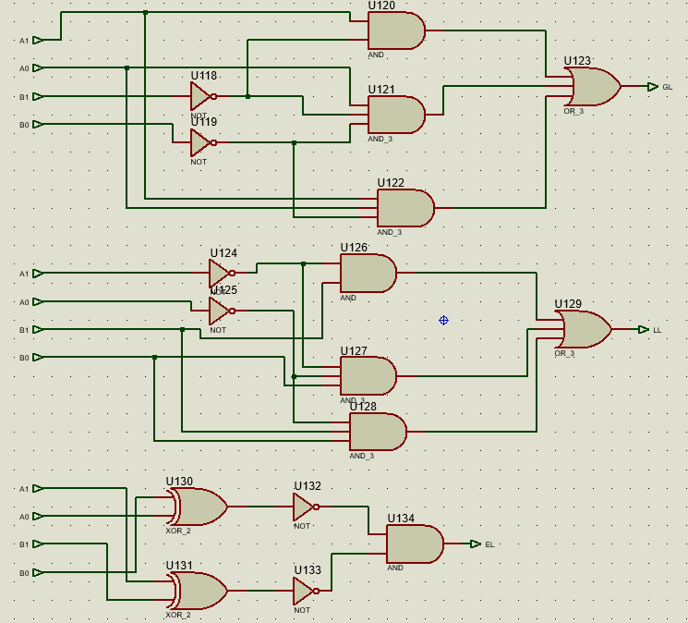
inputs |  |  |  | Outputs
A1 | A0 | B1 | B0 | Gl | El | Ll
0 | 0 | 0 | 0 | 0 | 1 | 0
0 | 0 | 0 | 1 | 0 | 0 | 1
0 | 0 | 1 | 0 | 0 | 0 | 1
0 | 0 | 1 | 1 | 0 | 0 | 1
0 | 1 | 0 | 0 | 1 | 0 | 0
0 | 1 | 0 | 1 | 0 | 1 | 0
0 | 1 | 1 | 0 | 0 | 0 | 1
0 | 1 | 1 | 1 | 0 | 0 | 1
1 | 0 | 0 | 0 | 1 | 0 | 0
1 | 0 | 0 | 1 | 1 | 0 | 0
1 | 0 | 1 | 0 | 0 | 1 | 0
1 | 0 | 1 | 1 | 0 | 0 | 1
1 | 1 | 0 | 0 | 1 | 0 | 0
1 | 1 | 0 | 1 | 1 | 0 | 0
1 | 1 | 1 | 0 | 1 | 0 | 0
1 | 1 | 1 | 1 | 0 | 1 | 0

Slide 21
Conditions to conclude that A>B, A=B or A<B
G ; A>B | Gu=1 and Gl=1
 | Gu=1 and Ll=1
 | Gu=1 and El=1
 | Eu=1 and Gl=1
L; A<B | Lu=1 and Ll=1
 | Lu=1 and Gl=1
 | Lu=1 and El=1
 | Eu=1 and Ll=1
A=B | Eu=1 and El=1

Slide 22
CONCLUSION
When the values of ‘A’ and ‘B’ are inputed, they enter both the arithmetic and the logic unit in which the operations are performed with respect to the values of S0 and S1
The output of both units enter a 2-1 multiplexer whose aim is to chose which output is to be shown with respect to the value of S2
The comperator also compare A and B then give us the relationship between A and B

Slide 23
PROJECT TWO :THE ANALYSIS, DESIGN AND IMPLEMENTATION OF BANK VAULT CONTROLER
PROBLEM
Design a bank vault the opens when either the president plug his key or both of the vice presidents plug their keys during working hours. OR IT opens when the president and atleast one vice president plug their keys during non-working hours.
INITIALISATION OF VARISBLED
Inputs
W=‘0’; non-working hours ,
‘1’; working hours.
X=‘0’ ; president does not plug his key,
‘1’ ; president plugs his key.
X=‘0’ ; 1ST vice president does not plug his key,
‘1’ ; 1st vice president plugs his key.
X=‘0’ ; 2nd vice president does not plug his key,
‘1’ ; 2nd vice president plugs his key.
Outputs
F=‘0’ ; Bank vault is closed
‘1’ ; Bank vault is open

Slide 24
inputs |  |  |  | Outputs
W | X | Y | Z | F
0 | 0 | 0 | 0 | 0
0 | 0 | 0 | 1 | 0
0 | 0 | 1 | 0 | 0
0 | 0 | 1 | 1 | 0
0 | 1 | 0 | 0 | 0
0 | 1 | 0 | 1 | 1
0 | 1 | 1 | 0 | 1
0 | 1 | 1 | 1 | 1
1 | 0 | 0 | 0 | 0
1 | 0 | 0 | 1 | 0
1 | 0 | 1 | 0 | 0
1 | 0 | 1 | 1 | 1
1 | 1 | 0 | 0 | 1
1 | 1 | 0 | 1 | 1
1 | 1 | 1 | 0 | 1
1 | 1 | 1 | 1 | 1
WXYZ | 00 | 01 | 11 | 10
00
01 |  | 1 | 1 | 1
11 | 1 | 1 | 1 | 1
10 |  |  | 1
F=X(W+Z+Y)+WZY

Slide 25
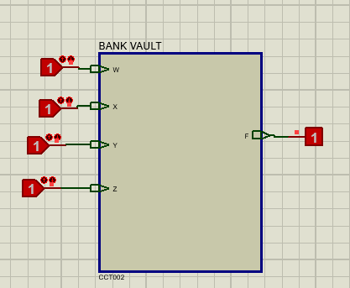
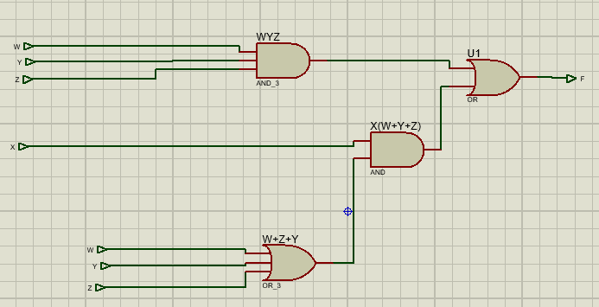

Slide 26
GENERAL CONCLUSION
We are at the end of our project and we wish to thank you for your kind attention

